Slide 1
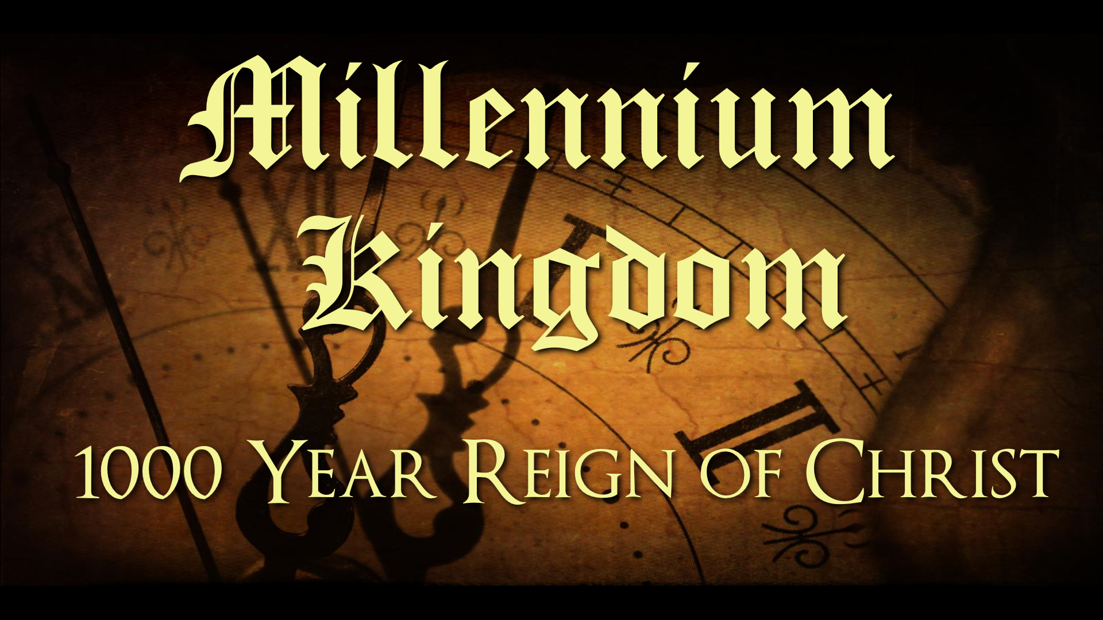
The Timeline of the Tribulation

Slide 2

The Timeline of the Tribulation
Revelation 6

Slide 3

Before the Tribulation Starts

Slide 4
Before the Tribulation Starts
Rapture

Slide 5
Before the Tribulation Starts
Destruction of America
(Jeremiah 50-51)

Slide 6
Before the Tribulation Starts
Rise of the Antichrist
(Daniel 7:23-24)

Slide 7
Before the Tribulation Starts
Battle of Gog and Magog
(Ezekiel 38,39)

Slide 8
Before the Tribulation Starts
Treaty with the Jewish People to Rebuild the Antichrist
(Daniel 9:27)

Slide 9

First Half of the Tribulation

Slide 10
First Half of the Tribulation
Seal Judgments
(Revelation 6)

Slide 11
First Half of the Tribulation
Trumpet Judgments
(Revelation 8, 9)

Slide 12
First Half of the Tribulation
144,000 Jewish Evangelists and Two Witnesses
(Revelation 7, 11)

Slide 13
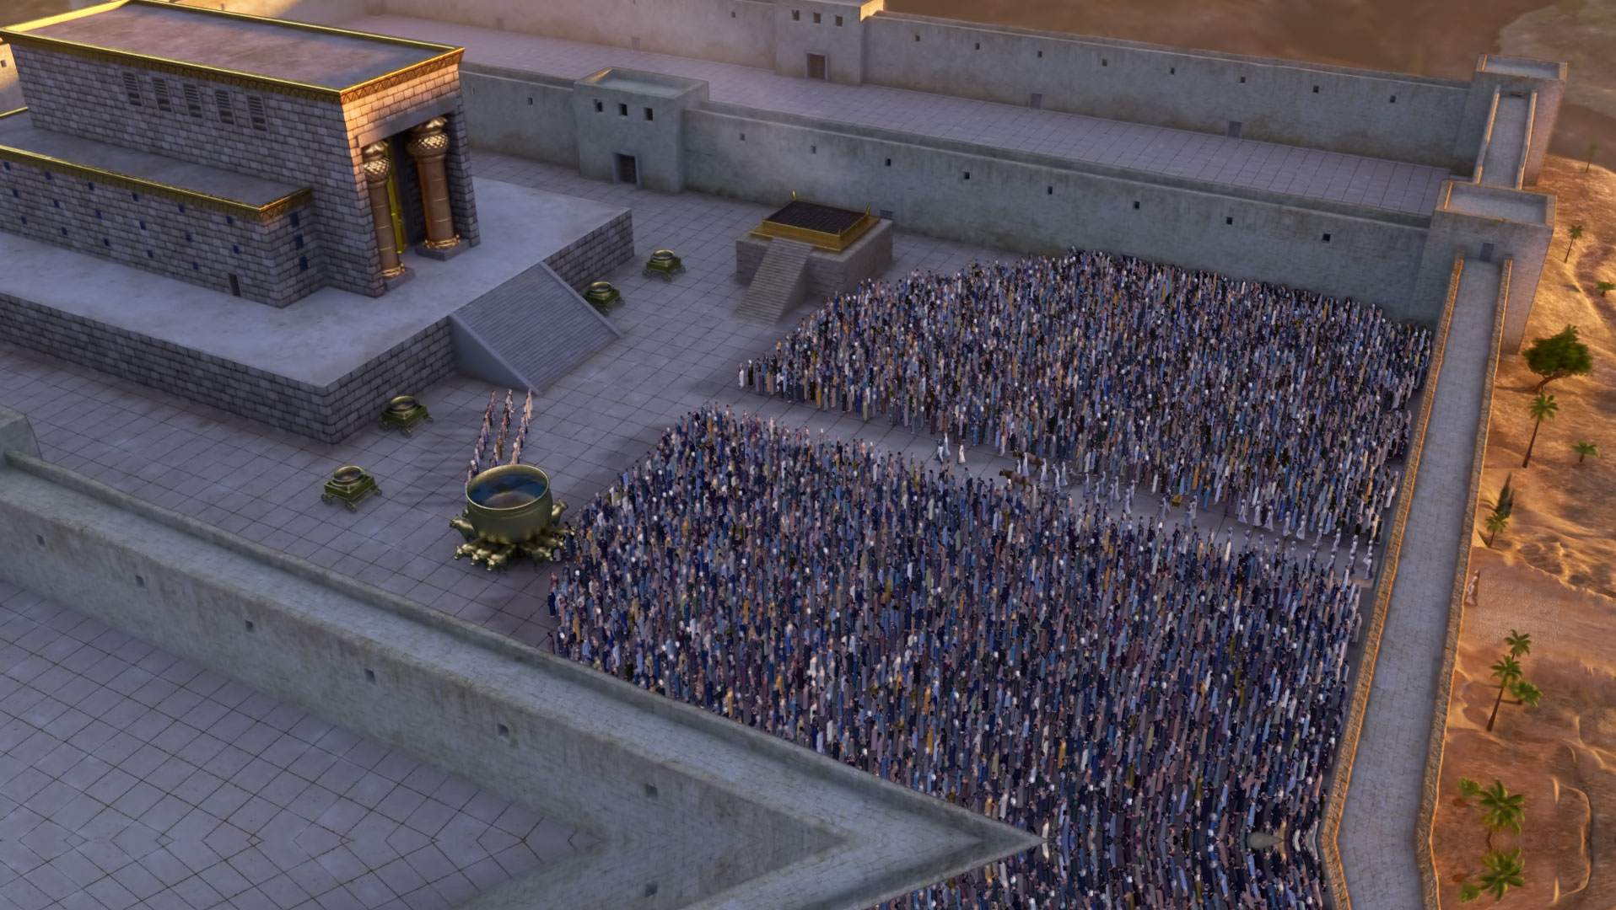
Mid-Point of Tribulation

Slide 14
Mid-Point of Tribulation
War in Heaven
(Revelation 12:7-12)

Slide 15
Mid-Point of Tribulation
Empowering of the Antichrist
(Revelation 13:1-4)

Slide 16
Mid-Point of Tribulation
Mark of the Beast
(Revelation 13:11-18)

Slide 17
Mid-Point of Tribulation
Abomination of Desolation
(Daniel 9:27,
Matthew 24:15-20,
Revelation 13:5-6)

Slide 18
Mid-Point of Tribulation
War Against Israel and the Believers Commences
(Daniel 9:25, Revelation 12:13-17, 13:7)

Slide 19

Second Half of the Tribulation

Slide 20
Second Half of Tribulation
The Bowls of Wrath
(Revelation 15, 16)

Slide 21
Second Half of Tribulation
The Destruction of Harlot Babylon
(Revelation 17)

Slide 22
Second Half of Tribulation
Battle of Armageddon
(Revelation 16:12-16, 19:19-21)

Slide 23
Second Half of Tribulation
Second Coming of Jesus Christ
(Revelation 19:11-16)

